Slide 1
Domain/Class Modeling
What is Class?

Slide 2
Approaches for identifying classes
1.Noun Phrase approach
2.Common class pattern
3.Class Responsibilities collaboration

Slide 3
1.Noun Phrase approach
-Noun Consider as class and verb method of class

Slide 4
Library management system is used by librarian.
Using this system , Librarian can issue book, return book for students and faculties.
Librarian can calculate fine if student return book after 15 days from issuing date.
To issue book, it is compulsory to
1.login the system by entering username and password.
2.search book to check availability.
If book available 3.enter students details : name, class, roll number, branch.

Slide 5
Requirement sources
Extract noun
Tentative class
Eliminates Spurious classes
classes

Slide 6
Class divided into three categories
1.Relevant classes
2.Fuzzy classes
3.Irrelevant classes

Slide 7
Library , librarian , system , book, book students ,faculties , Fine date
username and password.
name, class, roll number, branch.

Slide 8
Guidelines for identifying classes from fuzzy and relevant categories
1.Redundant classes
2.Irrelevant classes
3.Vague classes
4.Attributes
5.Adjective class
6.Operation
7.Implementation construct

Slide 9
Classes: Library , librarian , book, student ,faculty ,
Attributes:
date ,username and password.
name, class, roll number, branch.

Slide 10
2.Common class pattern Approach
1.Concept class-Reliability, Prediction
2.Event class-request, order,
3.Organization class-Department
4.People class-teacher , employee
5.Place class-stores , building
6.Tengible class and Device class-car
sensor

Slide 11
What is a CRC Card?
CRC stands for Class, Responsibility and Collaboration.
Class :
An object-oriented class name
• Include information about super- and sub-classes Responsibility
• What information this class stores
• What this class does
• The behavior for which an object is accountable
Collaboration
• Relationship to other classes
• Which other classes this class uses

Slide 12
CRC process
1.Identify the class responsibilities
2.Assign responsibilities
3.Identify collaborators

Slide 13
How to Create a CRC Model?
Read the description. Again. And again. Identify core classes (look for nouns).
Create a card per class (begin with class names only).
Add responsibilities ( look for verbs).
Which other classes does this class need to talk to fulfill its responsibilities?
Add collaborators.

Slide 14
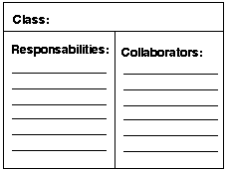

Slide 15
Librarian
Name
Id
Pass
Issue book()
Return book()
Calculate fine()
Search book()
Student
Book
faculty

Slide 16
Book
Name
Id
Author

Slide 17
Student
Name
Roll Number
Branch
class

Slide 18
Naming the classes
The class name should be singular
Start with capital letter
Be centered in the top compartment
Be written in italic if class is abstract
The name of class should reflect its intrinsic nature

Slide 19
Classes
A class is a description of a set of
objects that share the same attributes,
operations, relationships, and semantics.
Graphically, a class is rendered as a
rectangle, usually including its name,
attributes, and operations in separate,
designated compartments.
Class Name
attributes
operations

Slide 20
Class Names
ClassName
The name of the class is the only required tag in the graphical representation of a class. It always appears in the top-most compartment.
attributes
operations

Slide 21
Class Attributes
Person
An attribute is a named property of a
class that describes the object being modeled.
In the class diagram, attributes appear in
the second compartment just below the
name-compartment.
name : String
address : Address
birthdate : Date
ssn : Id

Slide 22
Class Attributes (Cont’d)
Attributes are usually listed in the form:
attributeName : Type
A derived attribute is one that can be
computed from other attributes, but
doesn’t actually exist.
For example,
a Person’s age can be computed from
his birth date. A derived attribute is
designated by a preceding ‘/’ as in:
/ age : Date
Person
name : String
address : Address
birthdate : Date
/ age : Date
ssn : Id

Slide 23
Class Attributes (Cont’d)
Person
+ name : String
# address : Address
# birthdate : Date
/ age : Date
- ssn : Id
Attributes can be:
+ public
# protected
- private
/ derived

Slide 24
Class Operations
Person
Operations describe the class behavior
and appear in the third compartment.
name : String
address : Address
birthdate : Date
ssn : Id
eat
sleep
work
play

Slide 25
Class Operations (Cont’d)
PhoneBook
newEntry (n : Name, a : Address, p : PhoneNumber, d : Description)
getPhone ( n : Name, a : Address) : PhoneNumber
You can specify an operation by stating its signature: listing the name, type, and default value of all parameters, and, in the case of functions, a return type.

Slide 26
Depicting Classes
When drawing a class, you needn’t show attributes and operation in every diagram.
Person
Person
Person
name : String
birthdate : Date
ssn : Id
Person
name
address
birthdate
eat()
sleep()
work()
play()
Person
eat
play

Slide 27
LMS-classes
Librarian
Name : String
id : int
pass : string
Issuebook()
Returnbook()
calculateFine()
Searchbook()

Slide 28
Class Responsibilities
A class may also include its responsibilities in a class diagram.
A responsibility is a contract or obligation of a class to perform a particular service.
SmokeAlarm
Responsibilities
-- sound alert and notify guard station
when smoke is detected.
-- indicate battery state

Slide 29
Class Relationships
In UML, object interconnections (logical or physical), are
modeled as relationships.
There are three kinds of relationships in UML:
Dependencies ---------------------->
Generalizations (super-sub structure)
Associations
Realization (interface)

Slide 30
Dependency Relationships
A dependency indicates a semantic relationship between two or
more elements.
-weakest relationship , read as “uses a”
The dependency from CourseSchedule to Course exists because Course is used in both the add and remove operations of CourseSchedule.
CourseSchedule
Course
add(c : Course)
remove(c : Course)

Slide 31
-can have name , if you have a model with many dependencies.

Slide 32
LMS-classes
Librarian
Name : String
id : int
pass : string
Book
Uses
Id
Author
Name
Issuebook()
Returnbook()
calculateFine()
Searchbook()

Slide 33
Generalization Relationships
A generalization connects a subclass
to its superclass.
It denotes an inheritance of attributes and behavior from the superclass to the subclass and indicates a specialization in the subclass of the more general superclass.
-not use name and multiplicity
-”is a” relationship
Person
Student

Slide 34
Generalization Relationships (Cont’d)
UML permits a class to inherit from multiple superclasses, although some programming languages (e.g., Java) do not permit multiple inheritance.
Student
Employee
TeachingAssistant

Slide 35
Generalization Relationships-LMS
Library Member
Student
Faculty

Slide 36
Association Relationships
-If two classes in a model need to communicate with each other, there must be link between them.
An association denotes that link.
-represent physical or conceptual connection between two or more object.
- “has a” relationship
Instructor
Student

Slide 37
Association types
1.Binary- Association between two class
2.n-ary- Association among three or more classes.

Slide 38
Identifying associations
-Is the class capable of fulfilling the required task by itself?
-If not what does it need?
-From other class can it acquire what it needs?

Slide 39
Association Relationships (Cont’d)
We can indicate the multiplicity of an association by adding multiplicity adornments to the line denoting the association.
The example indicates that a Student has one or more Instructors:
Student
Instructor
1..*
Person
Car
1..*
0..*

Slide 40
Multiplicity
Express how many instants of a particular class are involved in a relationship
-default 1
0…1-Zero to one
0…*-Zero to many
1…*-one to many

Slide 41
Association Relationships
The example indicates that every Instructor has one or more Students:
Student
Instructor
1..*

Slide 42
Association Relationships-association name
We can also name the association.
membership
Student
Team
1..*
1..*

Slide 43
Association Name
Person
owns
Car
owned by

Slide 44
Association Relationships
We can specify dual associations.
member of
Student
Team
1..*
1..*
1
president of
1..*

Slide 45
Association Relationships- Role name
We can also indicate the behavior of an object in an association (i.e., the role of an object) using rolenames.
teaches
learns from
Student
Instructor
1..*
1..*

Slide 46
Association Relationships- Role name
employer
employee
Company
Person
1..*
Works for
Person
Company

Slide 47
Association Relationships
We can constrain the association relationship by defining the navigability of the association. Here, a Router object requests services from a DNS object by sending messages to (invoking the operations of) the server. The direction of the association indicates that the server has no knowledge of the Router.
Router
DomainNameServer

Slide 48
Association Relationships
Person
Car
Bidirectional Association
owns
Person
Car
0…*
unidirectional Association

Slide 49
Association Relationships- self association
Association end names (Role) are necessary
For association between two object of the same class.
-self association/ reflexsive

Slide 50
Association Relationships- self association
A class can have a self association.
next
LinkedListNode
previous

Slide 51
Association Relationships- self association
A class can have a self association.
Captain
Team
Players

Slide 52
Association Relationships (Cont’d)
Associations can also be objects themselves, called link classes or an association classes.
Registration
modelNumber
serialNumber
warrentyCode
Product
Warranty

Slide 53
Association Relationships
Accessible by
Access permission
File
User

Slide 54
Qualified association
A qualified association has a qualifier that is used to select an object (or objects) from a larger set of related objects, based upon the qualifier key.
Qualification reduces the multiplicity at the target end of the association, usually down from many to one, because it implies the selection of usually one instance from a larger set.

Slide 55
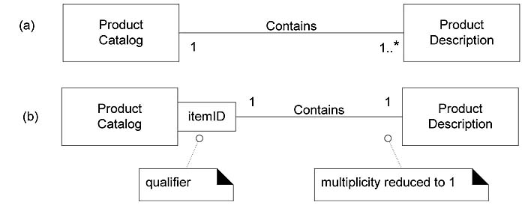

Slide 56
Qualified association
For example, if a ProductCatalog contains many ProductDescriptions, and each one can be selected by an itemID, then the UML notation in Figure can be used to depict this.
A qualified association is the UML equivalent of a programming concept variously known as associative arrays, maps, and dictionaries.

Slide 57
Bank
Account
1
0..1
Acc No
Bank
Account
1
*

Slide 58
Association Relationships :Aggregation
We can model objects that contain other objects by way of special associations called aggregations and compositions.
An aggregation specifies a whole-part relationship between an aggregate (a whole) and a constituent part, where the part can exist independently from the aggregate. Aggregations are denoted by a hollow-diamond adornment on the association.
“Has a” or “owns a” relationship
Car
Engine
Transmission

Slide 59
Properties of Association
1.Transitivity
Ex:A is part of B, B is part of A then A is part of C
2.Asymmetry:
Ex: A is part of B but B is not part of A

Slide 60
Association Relationships : Composition
A composition indicates a strong ownership and coincident lifetime of parts by the whole (i.e., they live and die as a whole). Compositions are denoted by a filled-diamond adornment on the association.
Window
Scrollbar
1
1
Titlebar
1
1
Menu
1
1 .. *

Slide 61
Association Relationships : Composition
Company
Division
Department
Person

Slide 62
Difference- Aggregation and Composition
Library
Book
Student

Slide 63
To identify a part of structure
1.Assembaly
Ex: computer and motherboard
2.Container
Ex: House and Chair
3.Collection number
Ex: football team

Slide 64
Interfaces
An interface is a named set of operations that specifies the behavior of objects without showing their inner structure. It can be rendered in the model by a one- or two-compartment rectangle, with the stereotype <<interface>> above the interface name.
<<interface>>
ControlPanel

Slide 65
Interface Services
<<interface>>
ControlPanel
Interfaces do not get instantiated. They have no attributes or state. Rather, they specify the services offered by a related class.
getChoices : Choice[]
makeChoice (c : Choice)
getSelection : Selection

Slide 66
Interface Realization Relationship
<<interface>>
ControlPanel
A realization relationship connects a class with an interface that supplies its behavioral specification. It is rendered by a dashed line with a hollow triangle towards the specifier.
specifier
implementation
VendingMachine

Slide 67
Guidelines for Generalization
Top Down
Bottom up

Slide 68
Identifying Attributes and Methods
-Use case Diagram
1.What information about an object should we keep track of?- Attribute
2.What service must a class provide?- method

Slide 69
For Method
-quires about attributes
-manage value of attributes
-maintain or change the value

Slide 70
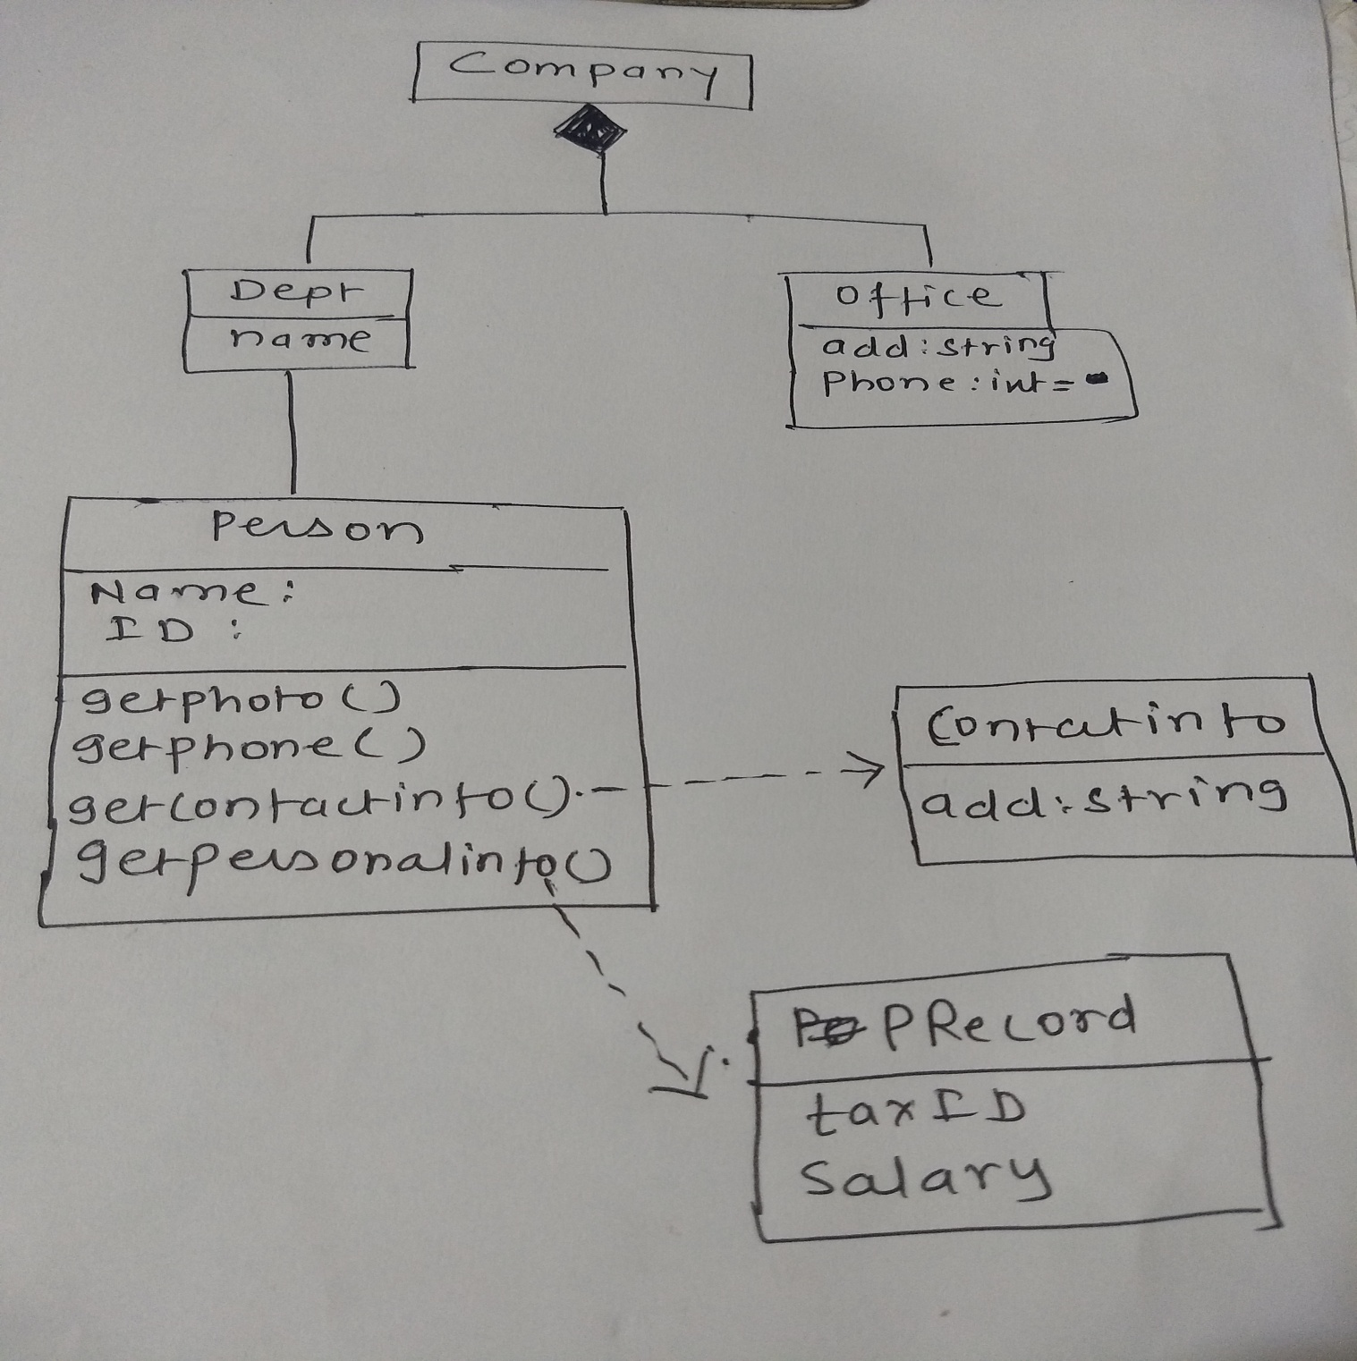

Slide 71
Dependency relationship
Librarian
Name : String
id : int
pass : string
Book
Id
Author
Name
Issuebook()
Returnbook()
calculateFine()
Searchbook()
Class Librarian
{
Public void issuebook(Book b)
{
}
}

Slide 72
Generalization Relationships
Class Person
{
}
Class student extends Person
{
}
Person
Student

Slide 73
Class A
Class B
Public class A
{
private B b
Public A()
{
b= new B()
}
}

Slide 74
Interface Realization Relationship
<<interface>>
A
Public interface A
{
}
Public class B implements A
{
}
specifier
implementation
B

Slide 75
Analysis Class Stereotypes
Analysis classes may be stereotyped as one of the following:
Boundary classes
Control classes
Entity classes
The Entity-Control-Boundary (ECB), or Entity-Boundary-Control (EBC), or Boundary-Control-Entity (BCE) is an architectural pattern used in use case driven object oriented software design that structures the classes composing a software according to their responsibilities in the use-case realization.

Slide 76
Boundary Class
A boundary class is a class used to model interaction between the system's surroundings and its inner workings.
Such interaction involves transforming and translating events and noting changes in the system presentation (such as the interface).

Slide 77
common boundary classes include windows, communication protocols, printer interfaces, sensors, and terminals.
A system may have several types of boundary classes:
User interface classes - classes which intermediate communication with human users of the system
System interface classes - classes which intermediate communication with other system
Device interface classes - classes which provide the interface to devices (such as sensors), which detect external events

Slide 78
Control Class
A control class is a class used to model control behavior specific to one or a few use cases.
Control objects (instances of control classes) often control other objects
Example: managing a queue of tasks

Slide 79
Control classes represent coordination, sequencing, transactions, and control of other objects and are often used to encapsulate control related to a specific use case.

Slide 80
Entity Class
An entity class is a class used to model information and associated behavior that must be stored.
Entity objects (instances of entity classes) are used to hold and update information about some phenomenon, such as an event, a person, or some real-life object.
They are usually persistent, having attributes and relationships needed for a long period, sometimes for the life of the system.
Entity objects represent the key concepts of the system being developed. Typical examples of entity classes in a banking system are Account and Customer.

Slide 81
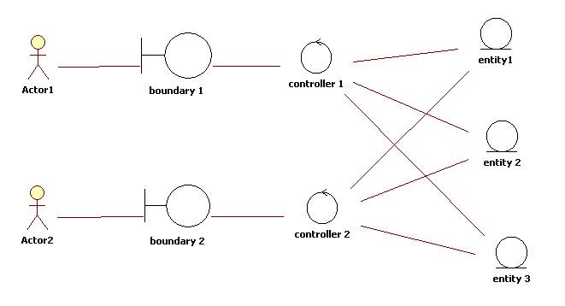

Slide 82
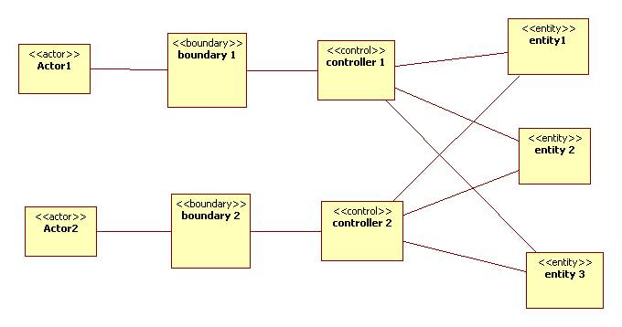

Slide 83
